Slide 1
Multithreading in JAVA
Prepared By: Dimple Bohra

Slide 2
What is multitasking ?
Multitasking is a process of executing multiple tasks simultaneously. We use multitasking to utilize the CPU.
Multitasking can be achieved in two ways:
Process-based Multitasking (Multiprocessing)
Thread-based Multitasking (Multithreading)

Slide 3
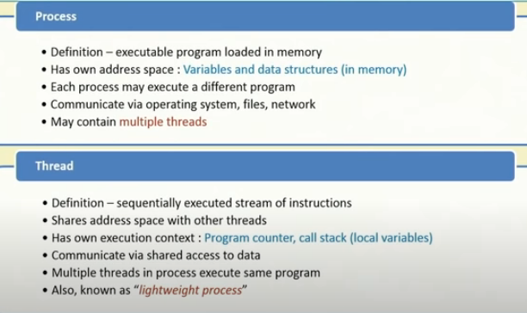
definition

Slide 4
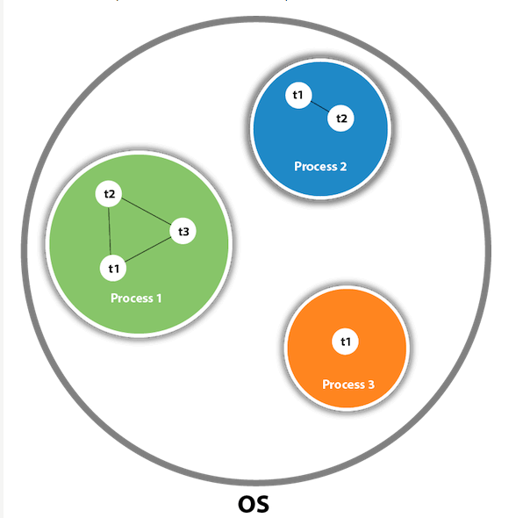

Slide 5
Process-based Multitasking (Multiprocessing)
Each process has an address in memory. In other words, each process allocates a separate memory area.
A process is heavyweight.
Cost of communication between the processes is high.
Switching from one process to another requires some time for saving and loading registers, memory maps, updating lists, etc.

Slide 6
Thread-based Multitasking (Multithreading)
Threads share the same address space.
A thread is lightweight.
Cost of communication between the thread is low.

Slide 7
multithreading
Multithreading in java is a process of executing multiple threads simultaneously.
A thread is a lightweight sub-process, the smallest unit of processing.
Multiprocessing and multithreading, both are used to achieve multitasking.
However, we use multithreading than multiprocessing because threads use a shared memory area.
They don't allocate separate memory area so saves memory, and context-switching between the threads takes less time than process.

Slide 8
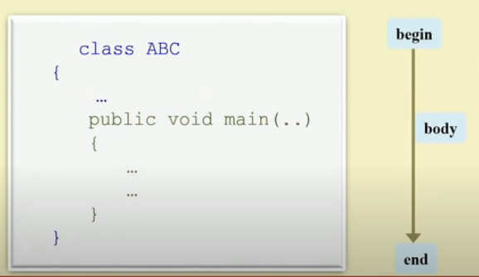
Single threaded program

Slide 9
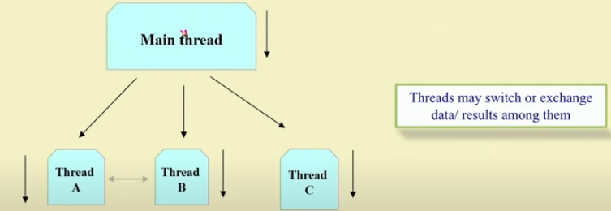
Multithreaded program

Slide 10
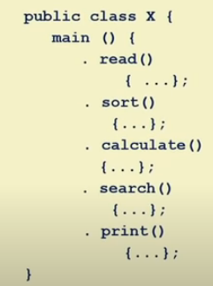
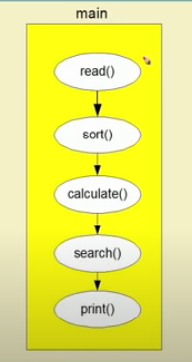
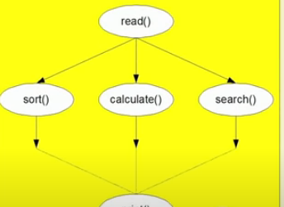
Simple example
Print()

Slide 11
Advantages of multithreading
1) It doesn't block the user because threads are independent and you can perform multiple operations at the same time.
2) You can perform many operations together, so it saves time.
3) Threads are independent, so it doesn't affect other threads if an exception occurs in a single thread.

Slide 12
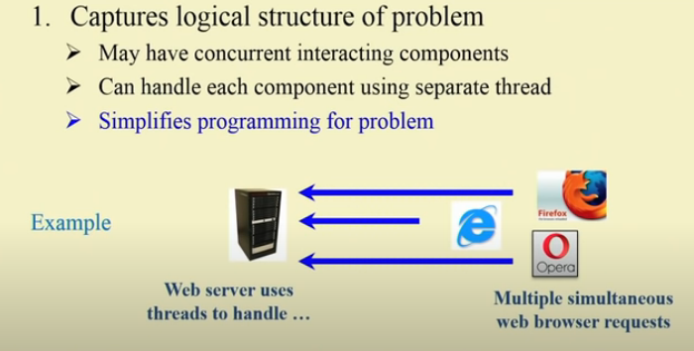
Why multithreading??

Slide 13
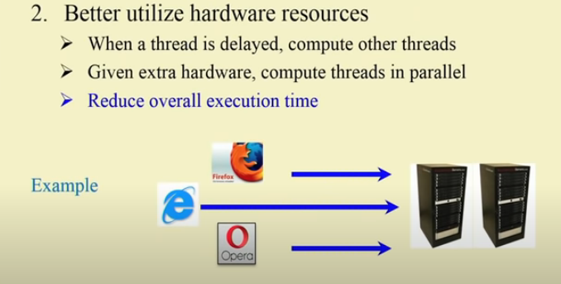
Why multithreading??

Slide 14
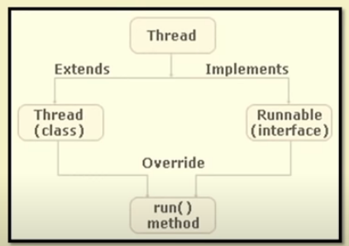

Slide 15
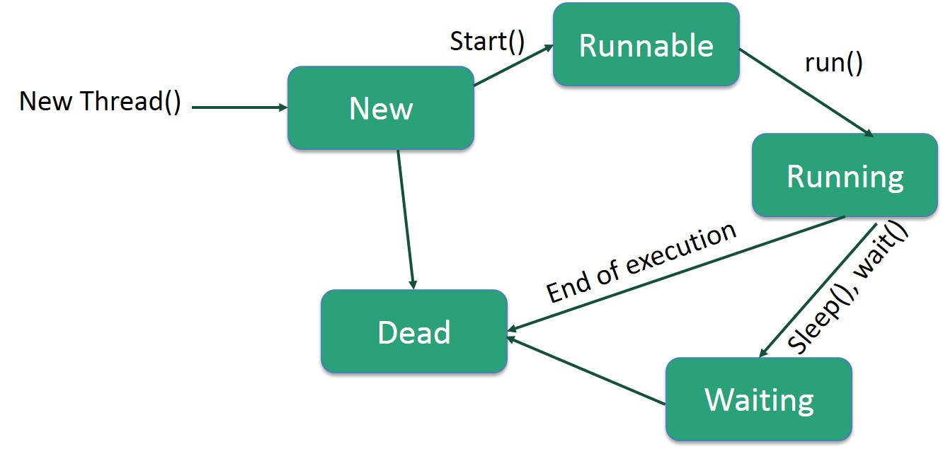
Life cycle of thread

Slide 16
Life cycle of thread
New: In this phase, the thread is created using class "Thread class". It remains in this state till the program starts the thread. It is also known as born thread.
Runnable: In this page, the instance of the thread is invoked with a start method. The thread control is given to scheduler to finish the execution. It depends on the scheduler, whether to run the thread.
Running: When the thread starts executing, then the state is changed to "running" state. The scheduler selects one thread from the thread pool, and it starts executing in the application.

Slide 17
Life cycle of thread
Waiting: This is the state when a thread has to wait. As there multiple threads are running in the application, there is a need for synchronization between threads. Hence, one thread has to wait, till the other thread gets executed. Therefore, this state is referred as waiting state.
Dead: This is the state when the thread is terminated. The thread is in running state and as soon as it completed processing it is in "dead state".

Slide 18
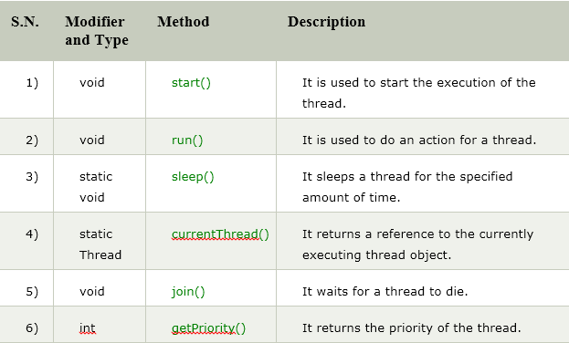
Built in methods associated with thread

Slide 19
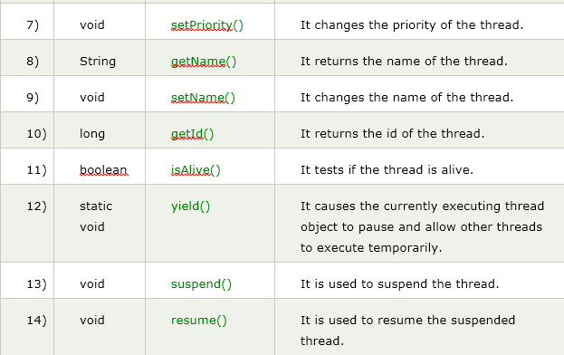
Built in methods associated with thread

Slide 20
How to use thread
Threads can be created by using two mechanisms:
1. Extending the Thread class
2. Implementing the Runnable Interface

Slide 21
Creation of class using thread class
We create a class that extends the java.lang.Thread class.
This class overrides the run() method available in the Thread class.
A thread begins its life inside run() method.
We create an object of our new class and call start() method to start the execution of a thread.
start() invokes the run() method on the Thread object.

Slide 22
class MultithreadingDemo extends Thread
{
public void run()
{
try
{
System.out.println ("Thread " +
Thread.currentThread().getId() +
" is running");
}
catch (Exception e)
{
System.out.println ("Exception is caught");
}
}
}
public class Multithread
{
public static void main(String[] args)
{
int n = 8; // Number of threads
for (int i=0; i<8; i++)
{
MultithreadingDemo object = new MultithreadingDemo();
object.start();
}
}
}

Slide 23
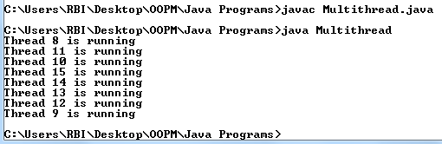
class MultithreadingDemo extends Thread
{
public void run()
{
try
{
System.out.println ("Thread " +
Thread.currentThread().getId() +
" is running");
}
catch (Exception e)
{
System.out.println ("Exception is caught");
}
}
}
public class Multithread
{
public static void main(String[] args)
{
int n = 8; // Number of threads
for (int i=0; i<8; i++)
{
MultithreadingDemo object = new MultithreadingDemo();
object.start();
}
}
}

Slide 24
Creation of class using runnable interface
1. We create a new class which implements java.lang.Runnable interface
2. Then we override run() method.
3. We instantiate a Thread object and call start() method on this object.

Slide 25
class MultithreadingDemo implements Runnable
{
public void run()
{
try
{
System.out.println ("Thread " +
Thread.currentThread().getName() +
" is running");
}
catch (Exception e)
{
System.out.println ("Exception is caught");
}
} }
class Multithread_runnable
{
public static void main(String[] args)
{
int n = 8; // Number of threads
for (int i=0; i<8; i++)
{
Thread object = new Thread(new MultithreadingDemo());
object.start();
}
}
}

Slide 26
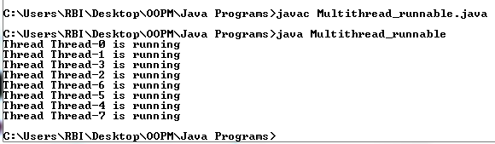
class MultithreadingDemo implements Runnable
{
public void run()
{
try
{
System.out.println ("Thread " +
Thread.currentThread().getName() +
" is running");
}
catch (Exception e)
{
System.out.println ("Exception is caught");
}
}
}
class Multithread_runnable
{
public static void main(String[] args)
{
int n = 8; // Number of threads
for (int i=0; i<8; i++)
{
Thread object = new Thread(new MultithreadingDemo());
object.start();
}
}
}

Slide 27
Thread class vs runnable interface
If we extend the Thread class, our class cannot extend any other class because Java doesn’t support multiple inheritance.
But, if we implement the Runnable interface, our class can still extend other base classes.

Slide 28
Synchronization in java
Synchronization in java is the capability to control the access of multiple threads to any shared resource.
Java Synchronization is better option where we want to allow only one thread to access the shared resource.

Slide 29
Why synchronization??
Multi threaded programs may often come to a situation where multiple threads try to access the same resources and finally produce erroneous and unforeseen results.
So it needs to be made sure by some synchronization method that only one thread can access the resource at a given point of time.
Java provides a way of creating threads and synchronizing their task by using synchronized blocks.

Slide 30
Synchronized block
Synchronized blocks in Java are marked with the synchronized keyword.
A synchronized block in Java is synchronized on some object.
All synchronized blocks synchronized on the same object can only have one thread executing inside them at a time.
All other threads attempting to enter the synchronized block are blocked until the thread inside the synchronized block exits the block.

Slide 31
Thread synchronization
There are two types of thread synchronization mutual exclusive and inter-thread communication.
Mutual Exclusive
Synchronized method.
Synchronized block.
static synchronization.
Cooperation (Inter-thread communication in java)

Slide 32
Mutual exclusive
Mutual Exclusive helps keep threads from interfering with one another while sharing data.
This can be done by three ways in java:
by synchronized method
by synchronized block
by static synchronization

Slide 33
Concept of lock in java
Synchronization is built around an internal entity known as the lock or monitor.
Every object has lock associated with it.
By convention, a thread that needs consistent access to an object's fields must acquire the object's lock before accessing them, and then release the lock when it's done with them.
package java.util.concurrent.locks contains many lock implementations

Slide 34
class Table{
void printTable(int n)
{
for(int i=1;i<=5;i++)
{
System.out.println(n*i);
try{
Thread.sleep(400);
}catch(Exception e){System.out.println(e);}
} } }
class MyThread1 extends Thread
{
Table t;
MyThread1(Table t)
{
this.t=t;
}
public void run()
{
t.printTable(5);
} }
class MyThread2 extends Thread
{
Table t;
MyThread2(Table t)
{
this.t=t;
}
public void run(){
t.printTable(100);
}}
class TestSynchronization1
{
public static void main(String args[])
{
Table obj = new Table();
MyThread1 t1=new MyThread1(obj);
MyThread2 t2=new MyThread2(obj);
t1.start();
t2.start();
}
}

Slide 35
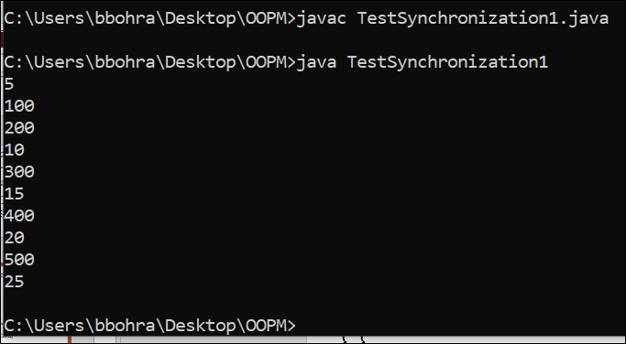
class Table{
void printTable(int n)
{
for(int i=1;i<=5;i++)
{
System.out.println(n*i);
try{
Thread.sleep(400);
}catch(Exception e){System.out.println(e);}
} } }
class MyThread1 extends Thread
{
Table t;
MyThread1(Table t)
{
this.t=t;
}
public void run()
{
t.printTable(5);
} }
class MyThread2 extends Thread
{
Table t;
MyThread2(Table t)
{
this.t=t;
}
public void run(){
t.printTable(100);
}}
class TestSynchronization1
{
public static void main(String args[])
{
Table obj = new Table();
MyThread1 t1=new MyThread1(obj);
MyThread2 t2=new MyThread2(obj);
t1.start();
t2.start();
}
}

Slide 36
Java synchronized method
If you declare any method as synchronized, it is known as synchronized method.
Synchronized method is used to lock an object for any shared resource.
When a thread invokes a synchronized method, it automatically acquires the lock for that object and releases it when the thread completes its task.

Slide 37
class Table{
synchronized void printTable(int n)
{
for(int i=1;i<=5;i++)
{
System.out.println(n*i);
try{
Thread.sleep(400);
}catch(Exception e){System.out.println(e);}
} } }
class MyThread1 extends Thread
{
Table t;
MyThread1(Table t)
{
this.t=t;
}
public void run()
{
t.printTable(5);
} }
class MyThread2 extends Thread
{
Table t;
MyThread2(Table t)
{
this.t=t;
}
public void run(){
t.printTable(100);
}}
class TestSynchronization1
{
public static void main(String args[])
{
Table obj = new Table();
MyThread1 t1=new MyThread1(obj);
MyThread2 t2=new MyThread2(obj);
t1.start();
t2.start();
}
}

Slide 38
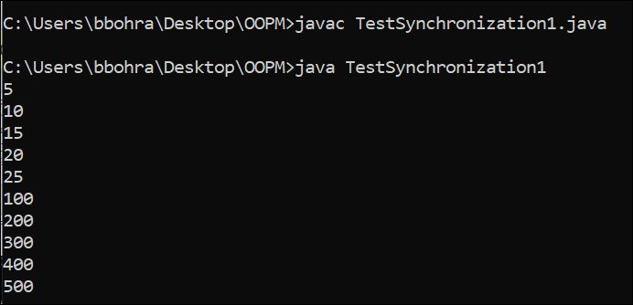
class Table{
synchronized void printTable(int n)
{
for(int i=1;i<=5;i++)
{
System.out.println(n*i);
try{
Thread.sleep(400);
}catch(Exception e){System.out.println(e);}
} } }
class MyThread1 extends Thread
{
Table t;
MyThread1(Table t)
{
this.t=t;
}
public void run()
{
t.printTable(5);
} }
class MyThread2 extends Thread
{
Table t;
MyThread2(Table t)
{
this.t=t;
}
public void run(){
t.printTable(100);
}}
class TestSynchronization1
{
public static void main(String args[])
{
Table obj = new Table();
MyThread1 t1=new MyThread1(obj);
MyThread2 t2=new MyThread2(obj);
t1.start();
t2.start();
}
}

Slide 39
class Table{
synchronized void printTable(int n)
{
for(int i=1;i<=5;i++)
{
System.out.println(n*i);
try
{
Thread.sleep(400);
}catch(Exception e){System.out.println(e);}
}
}
}
public class TestSynchronization3{
public static void main(String args[])
{
Table obj = new Table();
Thread t1=new Thread(){
public void run(){
obj.printTable(5);
}
};
Thread t2=new Thread(){
public void run(){
obj.printTable(100);
}
};
t1.start();
t2.start();
}
}

Slide 40
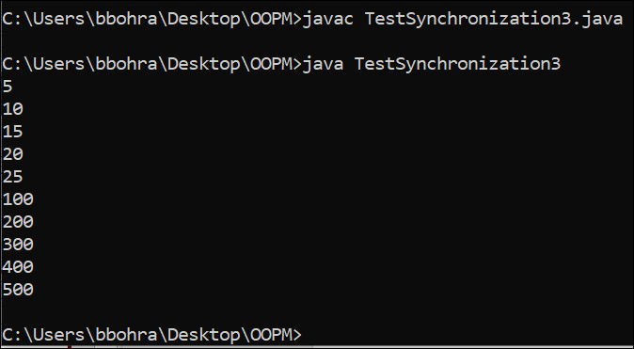
class Table{
synchronized void printTable(int n)
{
for(int i=1;i<=5;i++)
{
System.out.println(n*i);
try
{
Thread.sleep(400);
}catch(Exception e){System.out.println(e);}
}
}
}
public class TestSynchronization3{
public static void main(String args[])
{
Table obj = new Table();
Thread t1=new Thread(){
public void run(){
obj.printTable(5);
}
};
Thread t2=new Thread(){
public void run(){
obj.printTable(100);
}
};
t1.start();
t2.start();
}
}

Slide 41
Synchronized block in java
Synchronized block can be used to perform synchronization on any specific resource of the method.
Suppose you have 50 lines of code in your method, but you want to synchronize only 5 lines, you can use synchronized block.
If you put all the codes of the method in the synchronized block, it will work same as the synchronized method.

Slide 42
Points to remember for synchronized block
Synchronized block is used to lock an object for any shared resource.
Scope of synchronized block is smaller than the method.
Syntax to use synchronized block
synchronized (object reference expression)
{
//code block
}

Slide 43
class Table{
void printTable(int n){
synchronized(this){ //synchronized block
for(int i=1;i<=5;i++){
System.out.println(n*i);
try{
Thread.sleep(400);
}catch(Exception e){System.out.println(e);}
}
} //end of synchronized block
}//end of the method
}
public class TestSynchronizedBlock2{
public static void main(String args[]){
Table obj = new Table();//only one object
Thread t1=new Thread(){
public void run(){
obj.printTable(5);
}
};
Thread t2=new Thread(){
public void run(){
obj.printTable(100);
}
};
t1.start();
t2.start();
}
}

Slide 44
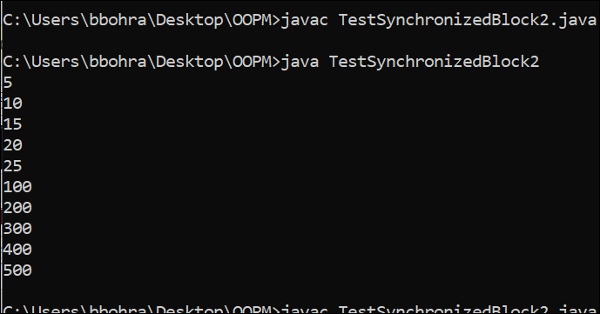
class Table{
void printTable(int n){
synchronized(this){ //synchronized block
for(int i=1;i<=5;i++){
System.out.println(n*i);
try{
Thread.sleep(400);
}catch(Exception e){System.out.println(e);}
}
} //end of synchronized block
}//end of the method
}
public class TestSynchronizedBlock2{
public static void main(String args[]){
Table obj = new Table();//only one object
Thread t1=new Thread(){
public void run(){
obj.printTable(5);
}
};
Thread t2=new Thread(){
public void run(){
obj.printTable(100);
}
};
t1.start();
t2.start();
}
}

Slide 45
class Table{
void printTable(int n){
synchronized(this){ }//synchronized block
for(int i=1;i<=5;i++){
System.out.println(n*i);
try{
Thread.sleep(400);
}catch(Exception e){System.out.println(e);}
}
}//end of the method
}
public class TestSynchronizedBlock2{
public static void main(String args[]){
Table obj = new Table();//only one object
Thread t1=new Thread(){
public void run(){
obj.printTable(5);
}
};
Thread t2=new Thread(){
public void run(){
obj.printTable(100);
}
};
t1.start();
t2.start();
}
}

Slide 46
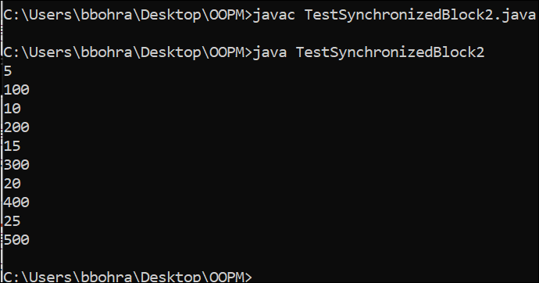
class Table{
void printTable(int n){
synchronized(this){ }//synchronized block
for(int i=1;i<=5;i++){
System.out.println(n*i);
try{
Thread.sleep(400);
}catch(Exception e){System.out.println(e);}
}
}//end of the method
}
public class TestSynchronizedBlock2{
public static void main(String args[]){
Table obj = new Table();//only one object
Thread t1=new Thread(){
public void run(){
obj.printTable(5);
}
};
Thread t2=new Thread(){
public void run(){
obj.printTable(100);
}
};
t1.start();
t2.start();
}
}

Slide 47
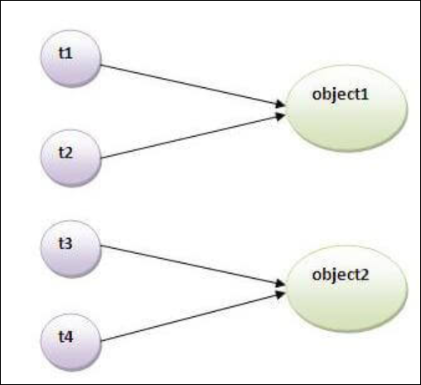
Static synchronization
Notes:
If you make any static method as synchronized, the lock will be on the class not on object.

Slide 48
Problem without static synchronization
Suppose there are two objects of a shared class(e.g. Table) named object1 and object2.
In case of synchronized method and synchronized block there cannot be interference between t1 and t2 or t3 and t4 because t1 and t2 both refers to a common object that have a single lock. But there can be interference between t1 and t3 or t2 and t4 because t1 acquires another lock and t3 acquires another lock.
We want no interference between t1 and t3 or t2 and t4.
Static synchronization solves this problem.

Slide 49
class Table{
synchronized static void printTable(int n){
for(int i=1;i<=3;i++){
System.out.println(n*i);
try{
Thread.sleep(400);
}catch(Exception e){}
}
}
}
public class TestSynchronization5 {
public static void main(String[] args) {
Thread t1=new Thread(){
public void run(){
Table.printTable(1);
}
};
Thread t2=new Thread(){
public void run(){
Table.printTable(10);
}
};
Thread t3=new Thread(){
public void run(){
Table.printTable(100);
}
};
Thread t4=new Thread(){
public void run(){
Table.printTable(1000);
}
};
t1.start();
t2.start();
t3.start();
t4.start();
} }

Slide 50
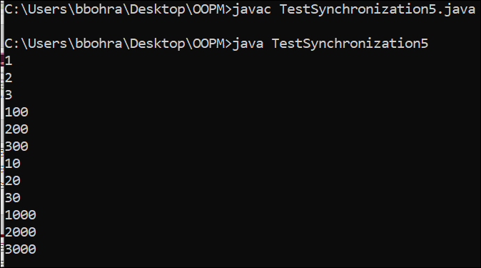
class Table{
synchronized static void printTable(int n){
for(int i=1;i<=3;i++){
System.out.println(n*i);
try{
Thread.sleep(400);
}catch(Exception e){}
}
}
}
public class TestSynchronization5 {
public static void main(String[] args) {
Thread t1=new Thread(){
public void run(){
Table.printTable(1);
}
};
Thread t2=new Thread(){
public void run(){
Table.printTable(10);
}
};
Thread t3=new Thread(){
public void run(){
Table.printTable(100);
}
};
Thread t4=new Thread(){
public void run(){
Table.printTable(1000);
}
};
t1.start();
t2.start();
t3.start();
t4.start();
} }

